Slide 2
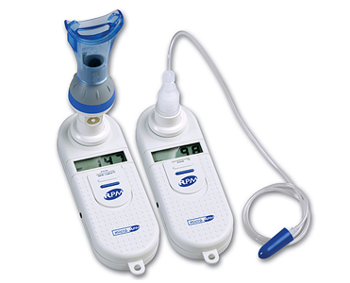
Respiratory Muscle Evaluation in Patient with Neuromuscular Disease
Dina Abouelkeir AbdAlla
Lecturer of Chest Medicine, MUH
2015

Slide 3
Involvement of respiratory muscles is a nearly constant feature of neuromuscular disorders, leading to respiratory failure.
The progression of respiratory complications to chronic respiratory failure in patients with NMD generally occurs as a direct consequence of two principal factors:
Weakness/ fatigue of respiratory muscles
Incapacity to maintain the airways free of secretions

Slide 4
History & Examination
Tests of Overall Respiratory Function
Tests of Respiratory Muscle Strength
Diaphragm strength

Slide 5
Generalized muscle weakness triggers the suspicion of neuromuscular disease as the cause of respiratory symptomatology.
Alternatively, respiratory failure can be the sole presenting manifestation of neuromuscular disease.
Symptoms due to respiratory muscle weakness include dyspnea, most often with exertion.
However, with severe limb muscle weakness, the patient’s ability to exert may be insufficient to elicit dyspnea.

Slide 6
As the disease progresses, dyspnea can occur at rest, a sign that respiratory failure may be imminent.
Involvement of the upper airway musculature:
Difficulties with speech or swallowing aspiration associated with dysphonia
Sleep-related breathing disorders
Peak expiratory flows can be so diminished that these individuals cannot adequately clear airway debris.

Slide 7
The physical examination:
May be normal during the initial stages
As the disease progresses, tachypnea at rest may be an early manifestation, associated with a decrease in tidal volume. This rapid shallow breathing pattern has the advantage of lowering the elastic work per breath but has the disadvantage of increasing dead space ventilation (increasing the dead space to tidal volume [VD:VT] ratio).

Slide 8
Normally, the abdomen and rib cage expand synchronously during inspiration.
With inspiratory and expiratory muscle weakness, this pattern of motion is altered. Diaphragm weakness may cause the abdomen to move inward as the rib cage expands during inspiration.
This pattern may be reversed with weakness of the inspiratory rib cage muscles.

Slide 9
Chest wall motion can be assessed using:
Magnetometers measure changes in rib cage and abdomen diameters.
Respiratory impedance plethysmograph measures changes in rib cage and abdomen cross-sectional areas.
Both techniques will detect paradoxical motion of the rib cage and abdomen and asynchronous motion that may not be noted during the physical exam.

Slide 10
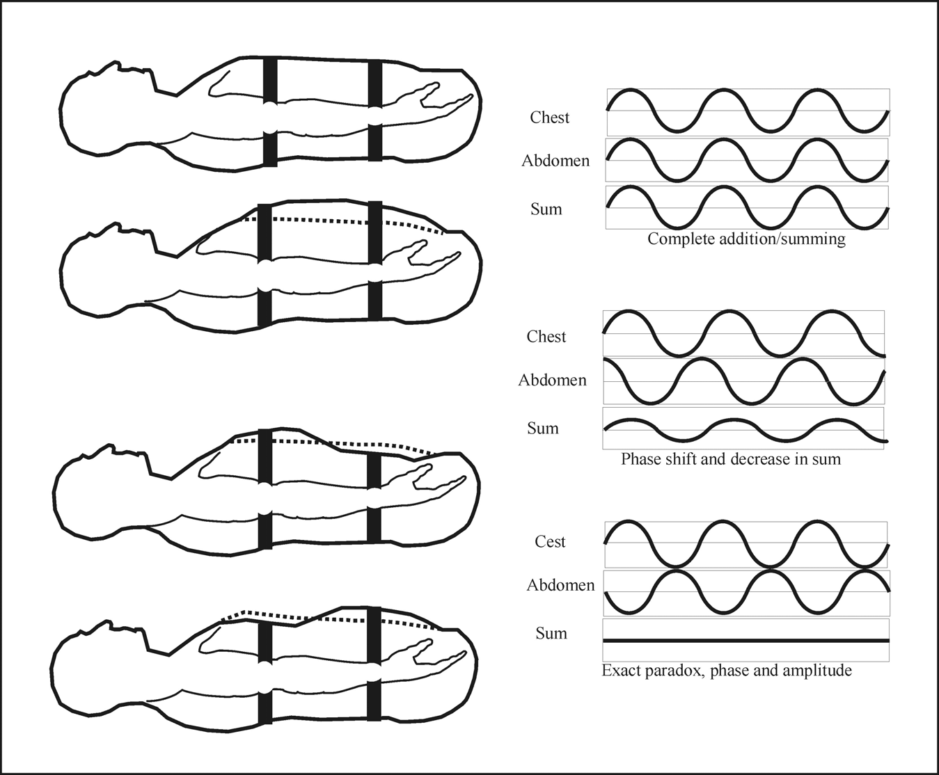
RIP

Slide 12
History & Examination
Tests of Overall Respiratory Function
Tests of Respiratory Muscle Strength
Diaphragm strength

Slide 13
1
Static Lung Volumes
2
Dynamic Spirometry and Maximum Flow
3
Maximum Voluntary Ventilation
4
5
6
7
Arterial Blood Gases: Awake
Measurements during Sleep
Carbon Monoxide Transfer
Exercise Testing

Slide 14
Static Lung Volumes
The most frequently noted abnormality of lung volumes in patients with respiratory muscle weakness is a reduction in vital capacity (VC).
Residual volume (RV) is usually normal or increased, the latter particularly with marked expiratory weakness.
RV/TLC ratios are often increased without necessarily implying airway obstruction.

Slide 15
Vital Capacity
Limited by weakness of both the inspiratory, and expiratory muscles
In mild respiratory muscle weakness, VC is less sensitive than maximum respiratory pressures
In more advanced disease, marked reductions in VC can occur with relatively small changes in maximum pressures.
In patients with isolated or disproportionate bilateral diaphragmatic weakness or paralysis, the VC shows a marked fall in the supine compared with the erect posture

Slide 16
In most normal subjects, VC in the supine position is 5–10% less than when upright.
A fall of 30% or more is generally associated with severe diaphragmatic weakness

Slide 17
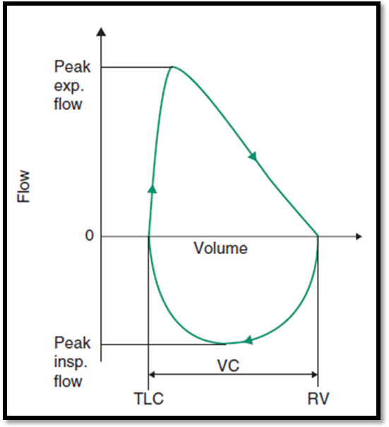
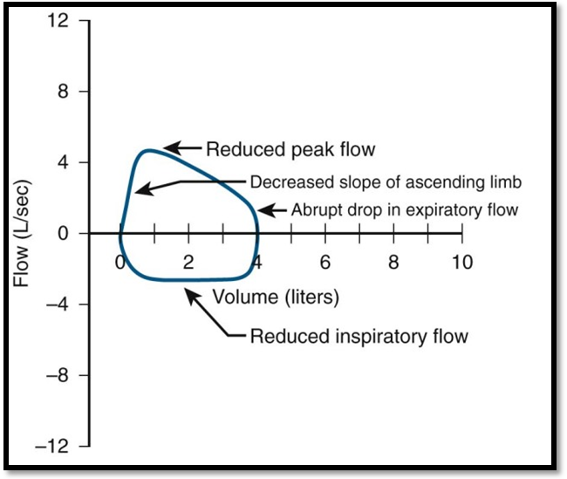
Dynamic Spirometry and Maximum Flow
Normal flow volume loop
moderate or severe respiratory muscle weakness

Slide 18
Saw-tooth appearance
Is it specific?

Slide 19
Saw-tooth appearance can also occur in:
Extrapyramidal disorders
Obstructive sleep apnea
Nonapneic snoring
Thermal injury of the upper airway

Slide 20
Maximum Voluntary Ventilation
It is highly effort dependent and is influenced by factors other than respiratory muscle function. These include airway resistance and respiratory system compliance.
Because it is a difficult and strenuous test to perform and adds little to more simple tests such as VC, it is no longer recommended in the evaluation and management of patients with respiratory muscle weakness

Slide 21
Arterial Blood Gases: Awake
PaO₂
Acute: marked
Chronic:
Mild
PaCO₂
Mild:
Advanced:

Slide 22
In the absence of primary pulmonary disease, daytime hypercapnia is unlikely unless:
Respiratory muscle strength is reduced to < 40% of predicted
and
VC is reduced to < 50% of predicted

Slide 23
Measurements during Sleep
During rapid eye movement (REM) sleep
Dips in oxygen saturation
gradual rise in PCO₂

Slide 24
Carbon Monoxide Transfer
TLCO
Normal or mildly reduced
KCO
Supernormal

Slide 26
History & Examination
Tests of Overall Respiratory Function
Tests of Respiratory Muscle Strength
Diaphragm strength

Slide 27
1
Maximal inspiratory and expiratory pressures
2
Sniff nasal inspiratory pressure
3
Peak cough flow
4
Diaphragm strength

Slide 28
Maximal inspiratory and expiratory pressures
Definition
Technique
Reference values
Advantages
Disadvantages
The primary tests for assessing respiratory muscle strength
MIP is the lowest pressure developed during a forceful inspiration against an occluded airway. It is recorded as a negative number.
MEP is the highest pressure developed during a forceful expiratory effort against an occluded airway. It is recorded as a positive number

Slide 29
P_{Imax} and P_{Emax} are obtained at the mouth with use of either a flanged mouthpiece or a tube mouthpiece that is connected to a mechanical pressure gauge.
The system requires a small leak (1-2 mm hole) to prevent glottis closure and to reduce the use of buccal muscles.
The inspiratory and expiratory pressure must be maintained, ideally for at least 1.5 seconds.
The maneuver should be repeated at least five times with the maximum value of three maneuvers that vary by less than 20% reported.
Definition
Technique
Reference values
Advantages
Disadvantages

Slide 30
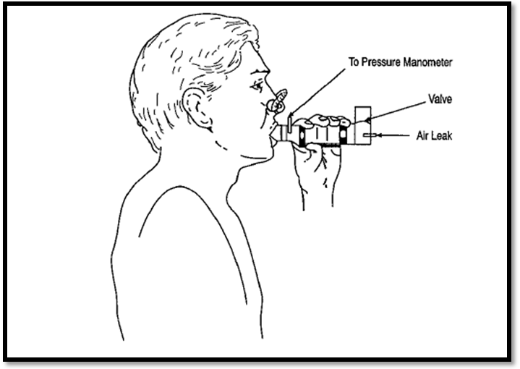
Measurement of maximal static respiratory pressures

Slide 31
The lung volume at which the maneuver is performed is critically important.
P_{Imax} is a measure of the diaphragm and other inspiratory muscles and is highest when obtained from RV.
P_{Emax} reflects the strength of the expiratory muscles (primarily abdominal muscles) and is highest when obtained from TLC.
Definition
Technique
Reference values
Advantages
Disadvantages

Slide 32
Definition
Technique
Reference values
Advantages
Disadvantages
Definitive reference values for P_{Imax} and P_{Emax} have not been established.
Differences in technique, mouthpiece design and lung volumes at which the measurement was obtained contribute to differences in published reference ranges.

Slide 33
Reference values with lower limits of normal for P_{Imax} and P_{emax}
Age (yr) | P_{Imax} (cmH₂O) (LLN) | P_{Emax} (cmH₂O) (LLN)
20–54 | Male: 124 (80) Female: 87 (55) | Male: 233 (149) Female: 152 (98)
55–59 | Male: 103 (71) Female: 77 (51) | Male: 218 (144) Female: 145 (105)
60–64 | Male: 103 (71) Female: 73 (47) | Male: 209 (135) Female: 140 (100)
65–85 | Male: 83 (65) Female: 57 (45) | Male: 174 (140) Female: 116 (90)
P_{Imax}: maximal inspiratory pressure, P_{Emax}: maximal expiratory pressure, LLN: lower limits of normal

Slide 34
Generalized neuromuscular weakness reduces both PI max and PE max
Isolated involvement of the diaphragm, such as with idiopathic diaphragm paralysis or the early stages of amyotrophic lateral sclerosis, may reduce only PI max

Slide 35
The “20–30–40 rule”
Respiratory failure is likely when:
VC is less than 20 mL/kg
P_{Imax} is less negative than(–)30 cm H₂O
P_{Emax} is less than 40 cm H₂O
A P_{Emax} less than 60 cm H₂O predicts an ineffective cough.

Slide 36
Widely used
Noninvasive
Can obtain at bedside
Reference values available
Predicts clinical consequences
Good NPV
Definition
Technique
Reference values
Advantages
Disadvantages

Slide 37
P_{Imax} and P_{Emax} are dependent on:
Lung volumes
Maximum effort
Proper technique
Patients with bulbar dysfunction may not be able to obtain a good seal on the mouthpiece, which will reduce maximum mouth pressures.
Definition
Technique
Reference values
Advantages
Disadvantages

Slide 38
Because of these factors, the PPV of P_{Imax} and P_{Emax} is relatively low.
Normal values exclude significant respiratory muscle weakness, but low values may reflect poor effort or technique or may be due to alterations in lung volumes rather than respiratory muscle dysfunction.
Definition
Technique
Reference values
Advantages
Disadvantages

Slide 39
Respiratory Pressure Meter MicroRPM™

Slide 40
Sniff nasal inspiratory pressure
The sniff nasal inspiratory pressure (SNIP) is a simple and non invasive test of global inspiratory muscle strength.
A plug, connected to a pressure transducer, is wedged into one nostril.
The patient is instructed to make short, sharp, maximal inspiratory efforts (sniffs) through the unobstructed nostril.
During the sniff, the nasal valve of the patent nostril collapses and the pressure measured beyond the collapsed segment closely reflects intrathoracic pressure and, therefore, inspiratory muscle strength.

Slide 41
The measurement of SNIP is particularly useful in patients with NMD with facial muscle weakness because it obviates the use of a mouthpiece.
The best value of at least 10 trials is considered.
SNIP values > 60 cmH₂O in women and > 70 cmH₂O in men eliminate a significant weakness of inspiratory muscles.
It is useful in monitoring respiratory muscle strength in patients with ALS; a value less than 40 cmH₂O is a sensitive test for predicting mortality

Slide 42
The SNIP and the P_{Imax} are complementary tests of inspiratory muscle strength, and the highest pressure of either test should be considered.
Combining the SNIP measurement with P_{Imax} reduces the number of false-positive diagnoses of inspiratory muscle weakness by 19%
The SNIP test is unreliable in patients with upper airway distortion and nasal congestion.

Slide 43
Peak cough flow
The peak expiratory flow can be measured during a vigorous cough effort and is called the peak cough flow (PCF).
It is measured either with a peak-flow meter or with a pneumotachograph.
The best of 4 to 7 trials is considered.
Normal values of PCF are > 350 l/min in the adult.
Patients with PCF values < 270 l/min are at risk of secretion retention and respiratory failure in case of pulmonary infection
Those with PCF values < 160 l/min are totally unable to clear their airways

Slide 44
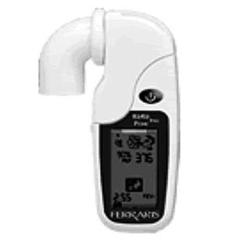
Digital peak expiratory flow meter

Slide 46
History & Examination
Tests of Overall Respiratory Function
Tests of Respiratory Muscle Strength
Diaphragm strength

Slide 47
Diaphragm strength
Trans-diaphragmatic pressure
Diaphragm thickness
Phrenic nerve stimulation

Slide 48
Transdiaphragmatic pressure (P_{di})
Diaphragm contraction lowers intrathoracic pressure while increasing intra-abdominal pressure.
Pressure developed specifically by the diaphragm can be measured as the difference between abdominal pressure, as assessed with a gastric catheter (Pga), and the pleural pressure, as assessed with an esophageal catheter (Pes).
Transdiaphragmatic pressure (Pdi) is then calculated as
Pdi = Pga - Pes

Slide 49
The measurement of maximum P_{di} (P_{di} max) can be obtained by having the patient inspire as forcefully as possible against a closed airway, which is known as the Mueller maneuver, or by having the patient sniff forcefully.
The peak P_{di} measured during a maximal sniff maneuver from FRC (sniff P_{di}) is the best test for diaphragm strength.
The best value of at least 10 trials is considered.
Sniff P_{di} values > 80 cmH₂O in women and > 100 cmH₂O in men eliminate a significant weakness of the diaphragm.

Slide 50
Advantage:
Specifically assessing diaphragm function
Disadvantages:
It requires placement of esophageal and gastric catheters that may be uncomfortable or even hazardous in patients with swallowing impairment.
In patients with diaphragm paralysis or profound respiratory muscle weakness, proper placement of the gastric catheter may be difficult because the changes in P_{ga} and P_{es} may parallel one another.
The maneuver needed to generate maximum trans-diaphragmatic pressure (P_{di} max) is complex and difficult to perform

Slide 51
Phrenic nerve stimulation
The phrenic nerves can be stimulated by either electrical or pulsed magnetic fields.
The diaphragm is innervated by the C3–C5 phrenic nerve roots, and all three branches are accessible to either form of stimulation.
The electric technique selectively stimulates the phrenic nerve and activates the diaphragm. In contrast, the magnetic technique is non-selective, not only stimulating the phrenic nerve but also the cervical nerve roots that, in turn, activate the muscles of the rib cage.

Slide 52
Phrenic nerve conduction time
The time from the onset of the stimulus to the onset of the diaphragm action potential
Assesses the integrity of the phrenic nerve
P_{di} following PNS
Measured as the magnitude of twitch P_{di}
Assesses the mechanical output of the diaphragm
A conduction time less than 9 msec is considered normal
In normals, P_{di} following bilateral electric PNS is generally between 25 and 35 cmH₂O

Slide 53
Advantage
It requires no patient effort.
Dawbacks
The magnitude of twitch P_{di} depends on the impedance of the abdomen and rib cage.
“contraction history”. Twitch potentiation is the phenomenon whereby twitch pressures are increased if there has been a preceding maximal contraction of the diaphragm.
The technology is not readily available to most clinicians

Slide 54
Imaging of the Diaphragm
CXR
Fluoroscopy
Ultrasound

Slide 55
Home Messages

Slide 56
1
Involvement of respiratory muscles is a nearly constant feature of NMD
2
Respiratory muscle dysfunction in patients with NMD is manifested in a variety of ways.
3
Upright and supine VC is very important to assess diaphragm

Slide 57
4
The “20–30–40 rule”
5
Sniff Pdi is the best test for diaphragm strength.
6
Neuromuscular ultrasound is an evolving technique that is now being used to image the diaphragm.

